Slide 1
Skepticism & meta-epistemology
Kareem Khalifa
Philosophy Department
Middlebury College

Slide 2
Overview
Background
Understanding
Internalism
Externalism

Slide 3
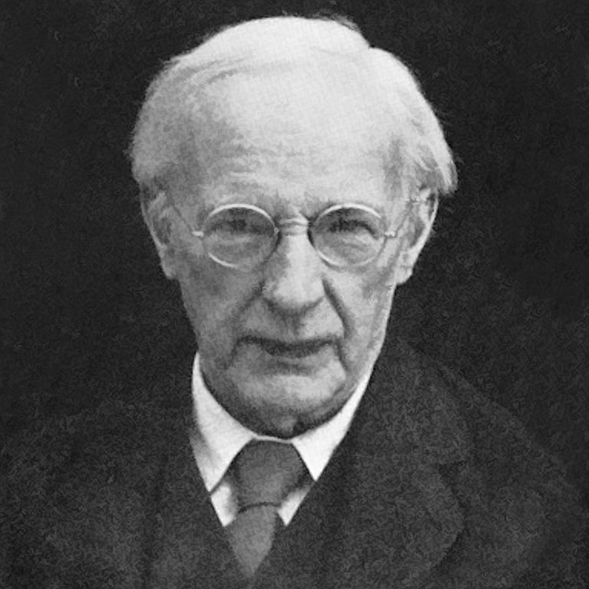
1. Background
1.1. Neo-Mooreanism
1.2. Externalism

Slide 4
2. Understanding Argument
2.1. The Main Argument
2.2. The Domain Argument

Slide 5
3. Internalism & epistemic principles
3.1. Against U2
3.2. Problems

Slide 6
4. Externalism and understanding
4.1. Externalism and U2
4.2. Stroud

